Slide 1
SweetStats- Unveiling the Diabetic (TASK-DS)
Predictive Model for Diabetes Detection
Developing a Machine Learning Model
Name : TALLADA SAI SHARAN Gmail : 20d41a04k5@gmail.com Batch : DS - 7

Slide 2
Contents
Sl. No | Title
1 | Introduction
2 | Data Exploration and Preprocessing
3 | Model Building
4 | Model Evaluation
5 | Model Comparison
6 | Conclusion

Slide 3
Introduction
Objective: Develop a predictive model to determine the likelihood of a patient developing diabetes.
Dataset: Diabetic dataset obtained from Kaggle
Features:
Pregnancies
Glucose
Blood Pressure
Skin Thickness
Insulin
BMI
Diabetes Pedigree Function
Age
Target Variable: Outcome (0 - No Diabetes, 1 - Diabetes)

Slide 4
Data Exploration and Preprocessing
Data Inspection:
Displayed the first 5 rows of the dataset and its structure using df.head() and df.info().
Data Summary:
Utilized df.describe() to summarize statistical details of the dataset.
Handling Missing Values:
Checked for missing values using df.isnull().sum() and found none.
Data Visualization:
Displayed pair plots using sns.pairplot() to visualize feature distributions.
Plotted a heatmap using sns.heatmap() to visualize correlations between features.

Slide 5
Model Building
Model Training:
Utilized Logistic Regression, Decision Tree and Random Forest models.
Split the dataset into training and testing sets using train_test_split().
Applied StandardScaler() to normalize features.

Slide 6
Model Evaluation
Logistic Regression:
Accuracy: 0.75
Decision Tree:
Accuracy: 0.77
Random Forest:
Accuracy: 0.76

Slide 7
Model Comparison
Performance Metrics:
AUC Scores:
Logistic Regression: 0.81
Decision Tree: 0.76
Random Forest: 0.83
Confusion Matrices and ROC Curves:
Displayed confusion matrices and ROC curves for all models (in upcoming slides)

Slide 8
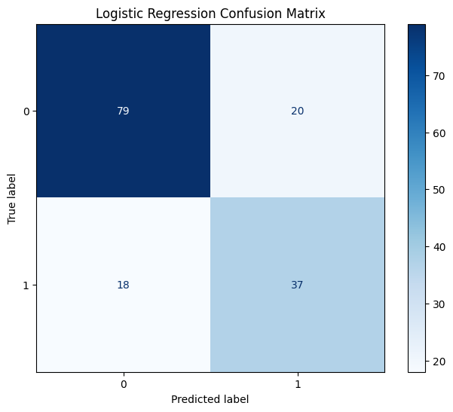

Slide 9
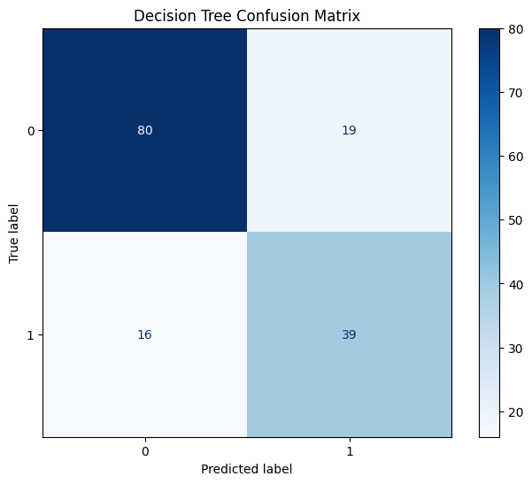

Slide 10
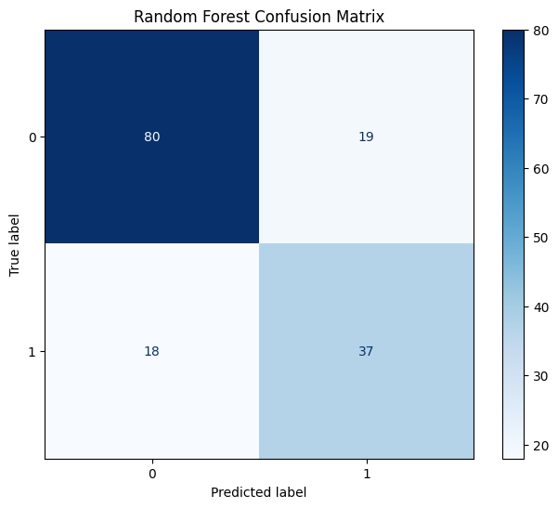

Slide 11
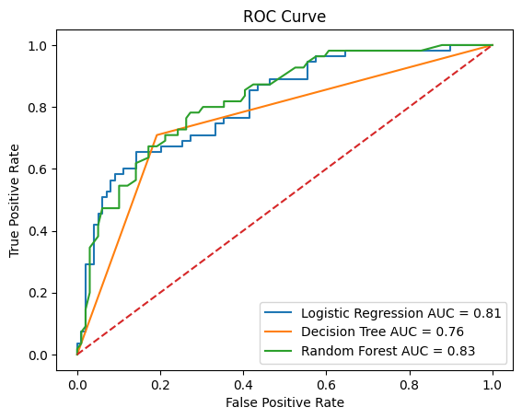

Slide 12

Conclusion
Random Forest performed the best with an accuracy of 0.76 and AUC of 0.83.

Slide 13


